Slide 1
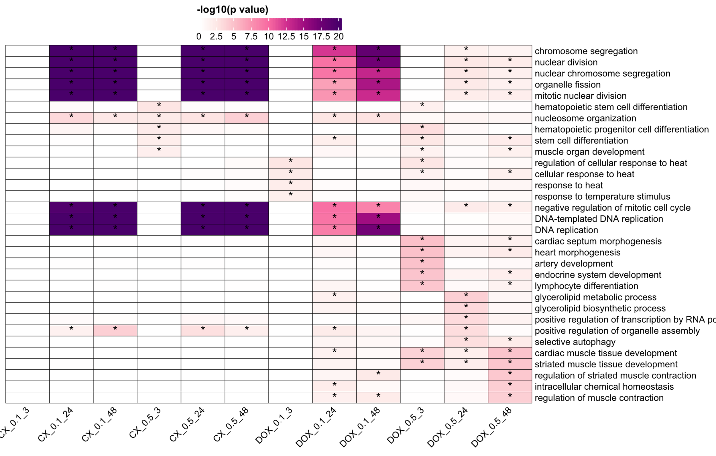
TOP GO terms across DEG Samples

Slide 2
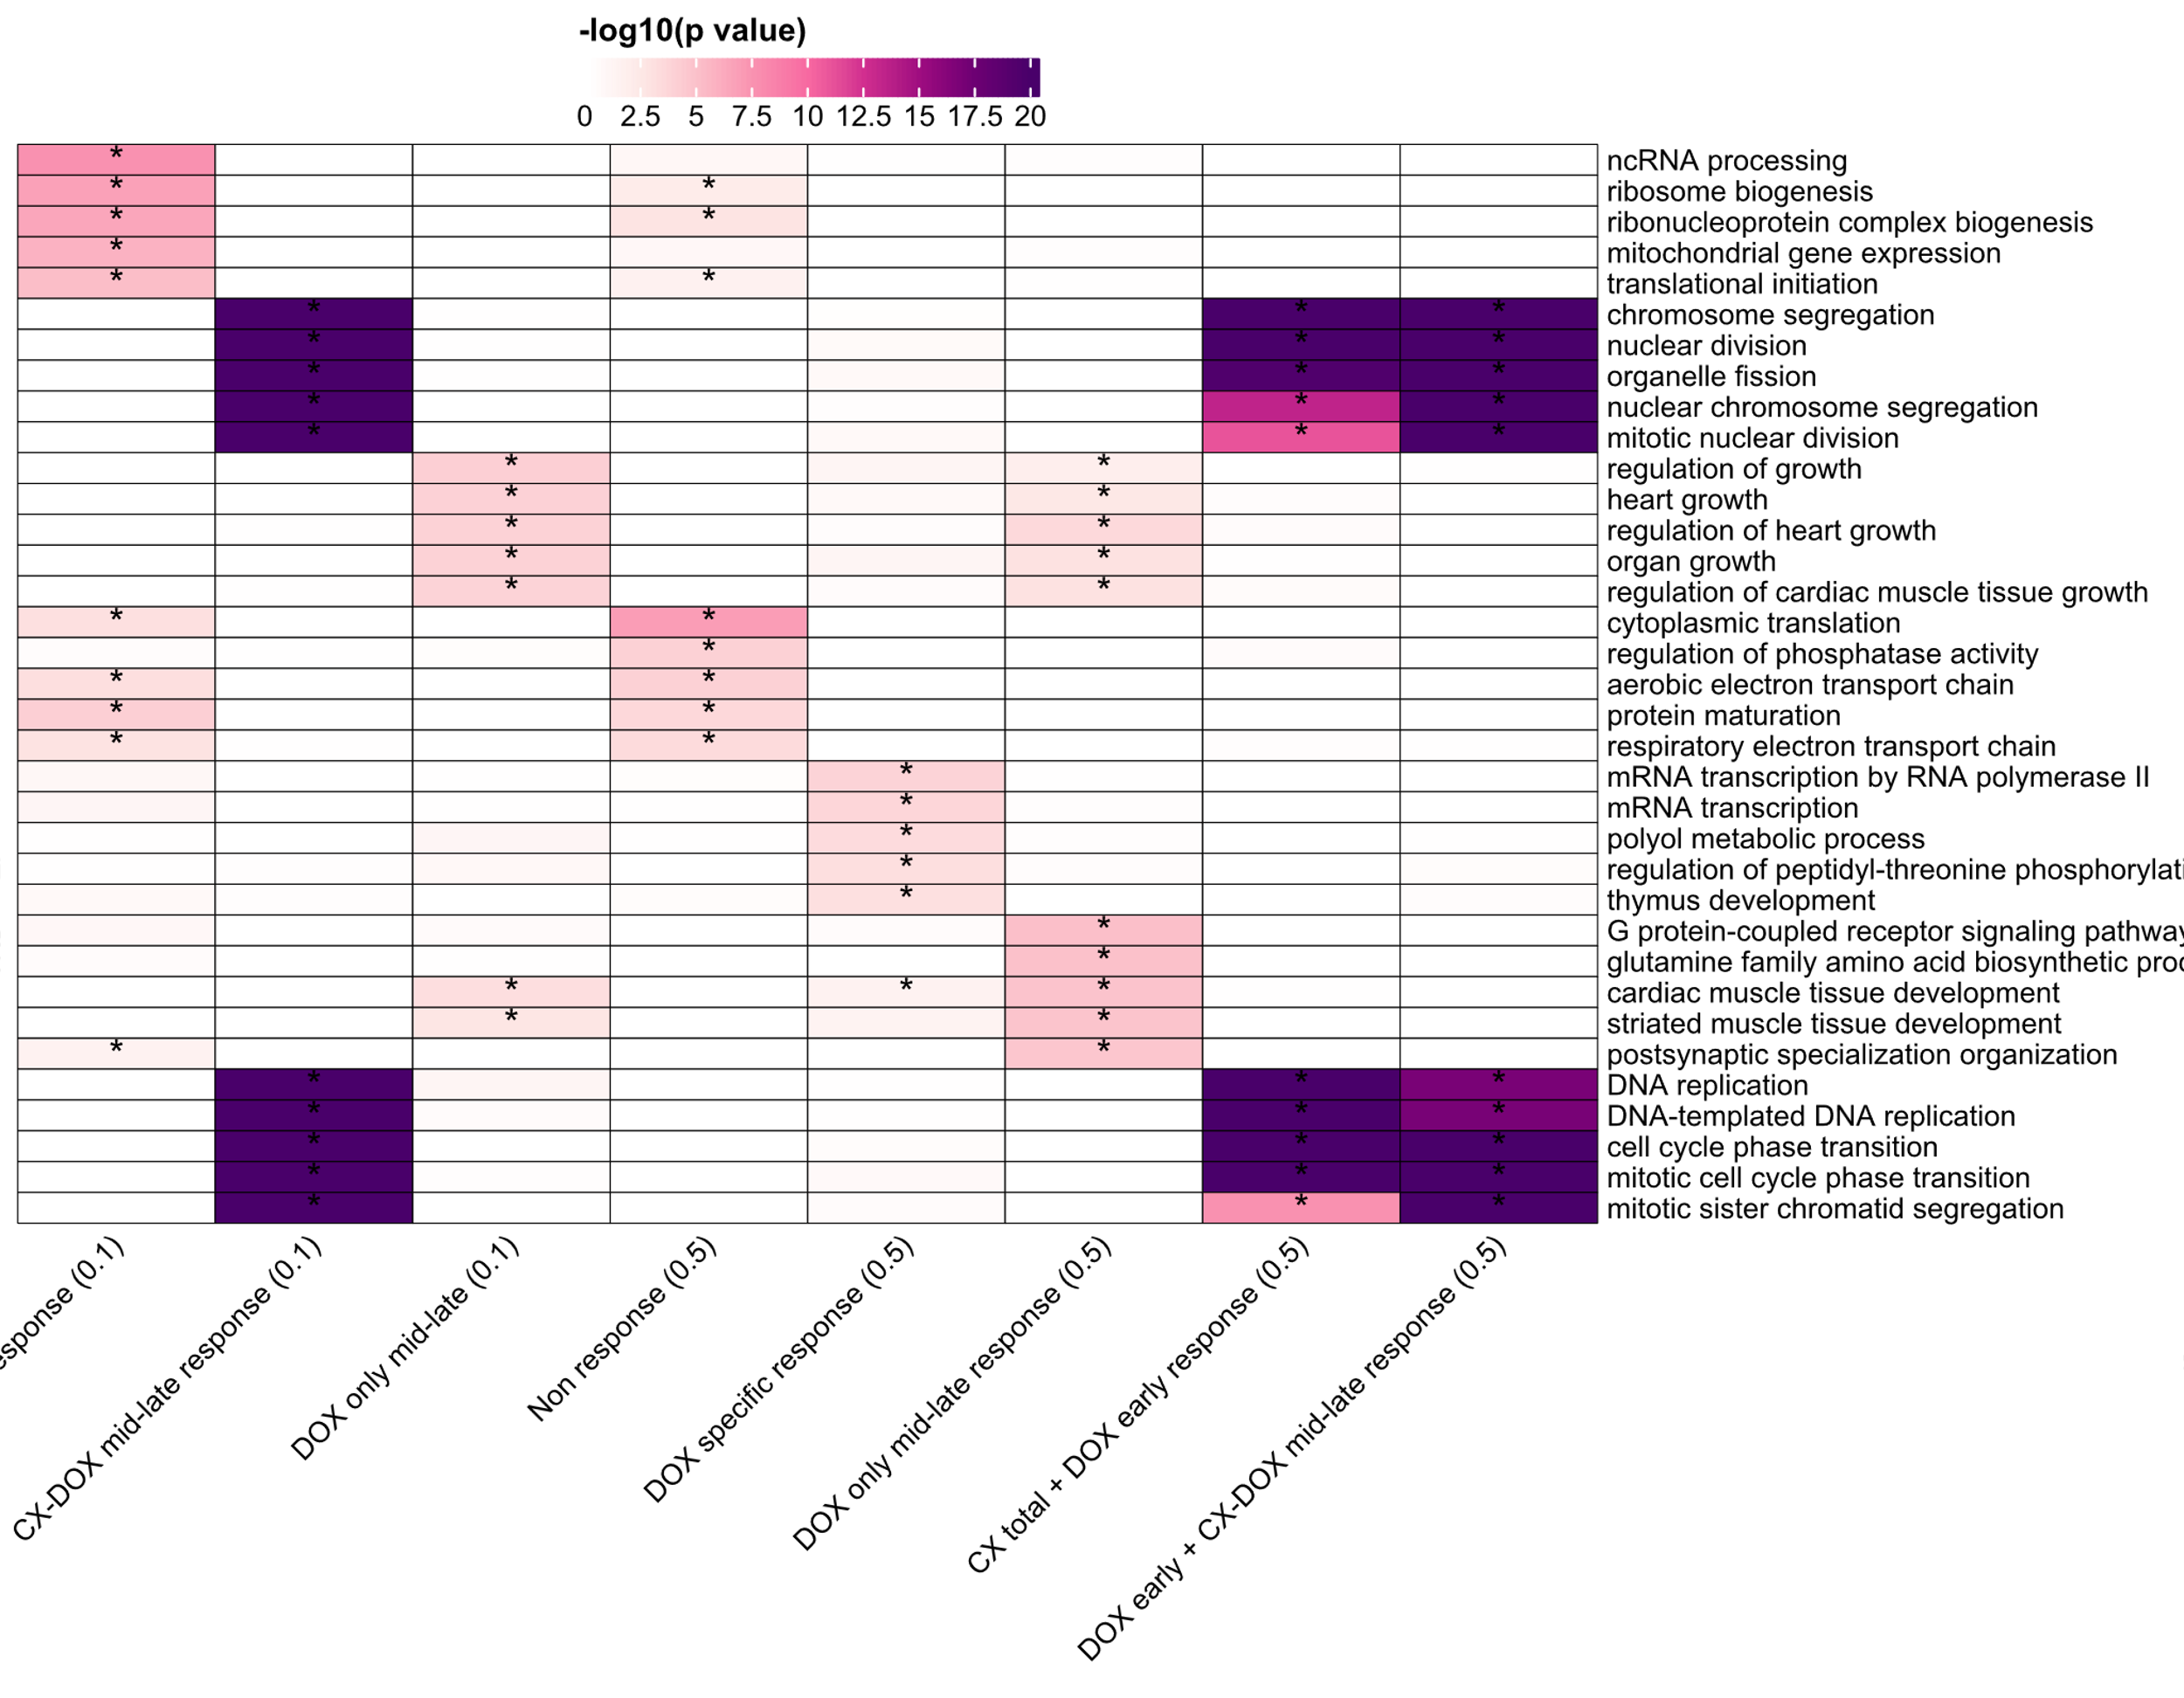
TOP GO terms across Cormotif Samples

